Slide 1


Pathogen watch
Gildas Hounmanou, PhD
APTI-Fellow, National Institutes of Health, MD, USA
Assistant-Professor
https://orcid.org/0000-0003-3991-0864
University of Copenhagen
Faculty of Health and Medical Sciences
Section for Food Safety and Zoonoses
Department of Veterinary and Animal Sciences

Slide 2
Learning outcomes
Use Pathogen Watch for bacterial species, AMR and ST prediction
Retrieve assemblies available from Pathogen Watch
Assess a collection of genome in Pathogen Watch
2/22/23
PRESENTATION TITLE

Slide 3
Agenda
Basic concepts
Bacterial species
Sequence typing methods
AMR prediction
Genome browser
2/22/23
PRESENTATION TITLE

Slide 4

Pathogen watch – basic concepts
Free online based platform
Oxford Big Data Institute
Comparing pathogen genome assemblies from around the world
Species assignment for 60,000 variants of bacteria, viruses & fungi – Speciator
Sequence typing
AMR prediction
cgMLST clustering and SNP-tree
Plasmid prediction
https://pathogen.watch/
2/22/23
PRESENTATION TITLE
4

Slide 5
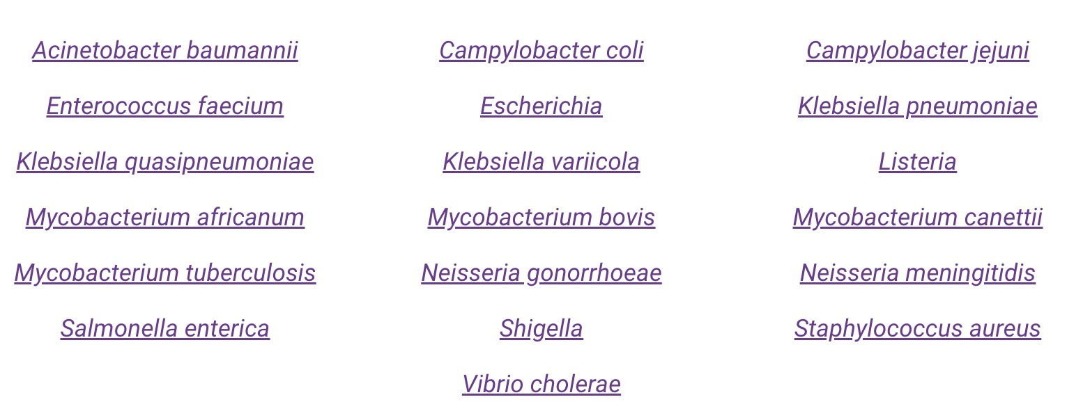
Pathogen watch – Bacterial species
2/22/23
PRESENTATION TITLE

Slide 6
Pathogen watch – Sequence typing methods
PopPunk – S. pneumoniae GPSC strain assignment
Pangolin – Phylogenetic Assignment of Named Global Outbreak LINeages
NG-MAST– Neisseria gonorrhoeae
multi-antigen sequence typing
Klebsiella LIN codes – Infers Klebsiella lineage codes
SeroBA
SISTR – Salmonella In Silico
Typing Resource
cgMLST
Genotyphi – S. Typhi
Kaptive - typing the surface polysaccharide loci of Klebsiella and A. baumannii
Kleborate – in-depth species, ST, virulence genes, capsule typing and antimicrobial resistance prediction for Klebsiella
MLST
Vista – Virulence and genotype annotation tool for Vibio cholerae

Slide 7
Pathogen watch – AMR prediction
Pathogen watch AMR
Kleborate – antimicrobial resistance prediction for
Klebsiella genus
SPN-PBP-AMR : Analysis of the Streptococcus pneumoniae PBPs and inferred MICs.
2/22/23
PRESENTATION TITLE

Slide 8
Pathogen watch – Browse genomes/collections
All assemblies currently available from pathogenwatch can be accessed via the "Genomes"
Pathogenwatch provides pre-generated collections of publicly available genomes from important papers, surveys and in-house collections.

Slide 9


Gildas Hounmanou, PhD
APTI-Fellow, National Institutes of Health, MD, USA
Assistant-Professor
https://orcid.org/0000-0003-3991-0864
University of Copenhagen
Faculty of Health and Medical Sciences
Section for Food Safety and Zoonoses
Department of Veterinary and Animal Sciences

